Slide 1
History
SQL Server 1.0 (1989) | Developed by Microsoft, Sybase, and Ashton-Tate for OS/2
SQL Server 4.2 (1992) | Developed for Windows NT 3.1
SQL Server 6.0 (1995) | First version architected specifically for Windows NT
SQL Server 7.0 (1999) | Total rewrite of code base resulted in performance and scalability improvements
SQL Server 2000 | Further improvements in performance, scalability, and reliability
SQL Server 2005 | New and improved features: Integration Services, Analysis Services, Notification Services, Reporting Services, XML support

Slide 2
New Features
Security/Auditing
  Transparent Data Encryption
  External Key Management
  Data Auditing
Availability/Reliability
  Hot Pluggable CPU support
  Enhanced Database Mirroring
Performance
  Data Compression
  Backup Compression
  Performance Data Collection
  Improved Plan Guide Support
  Resource Governor
Management
  Policy based Management
  Microsoft System Center Integration
  Extended Events

Slide 3
New Features
Development Enhancements
  Improved Datatypes
  HiarchyID
  Entity Data Model
  LinQ
  Change Data Capture
  Table Valued Parameters
  Large UDTS
  MERGE Statements
  XML Enhancements
  Service Broker Enhancements
  Spatial Data
Data Storage
  Data Compression
  FILESTREAM
  Integrated Full Text Indexing
  Sparse Columns
  New Index Types

Slide 4
New Features
Data Warehousing/ETL
  Partition Table Parallelism
  Star Join Support
  Persistent Lookups
  Improved Thread Scheduling
  MERGE Statement
  Change Data Capture
  Scale-out Analysis Services
  Subspace Computations
  Cube Design Enhancements
  Data Mining Add-ins for Excel
Reporting
  IIS Agnostic RS
  Sharepoint Integration
  Rich Text Support
  Report Designer
  Word/Excel Designing

Slide 5
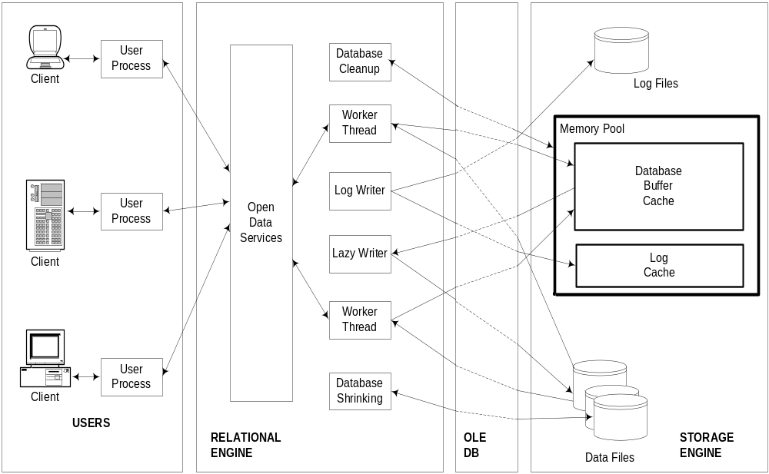
SQL Server programs

